Slide 1

HR Data Analysis
Using Microsoft Excel and Power BI

Slide 2
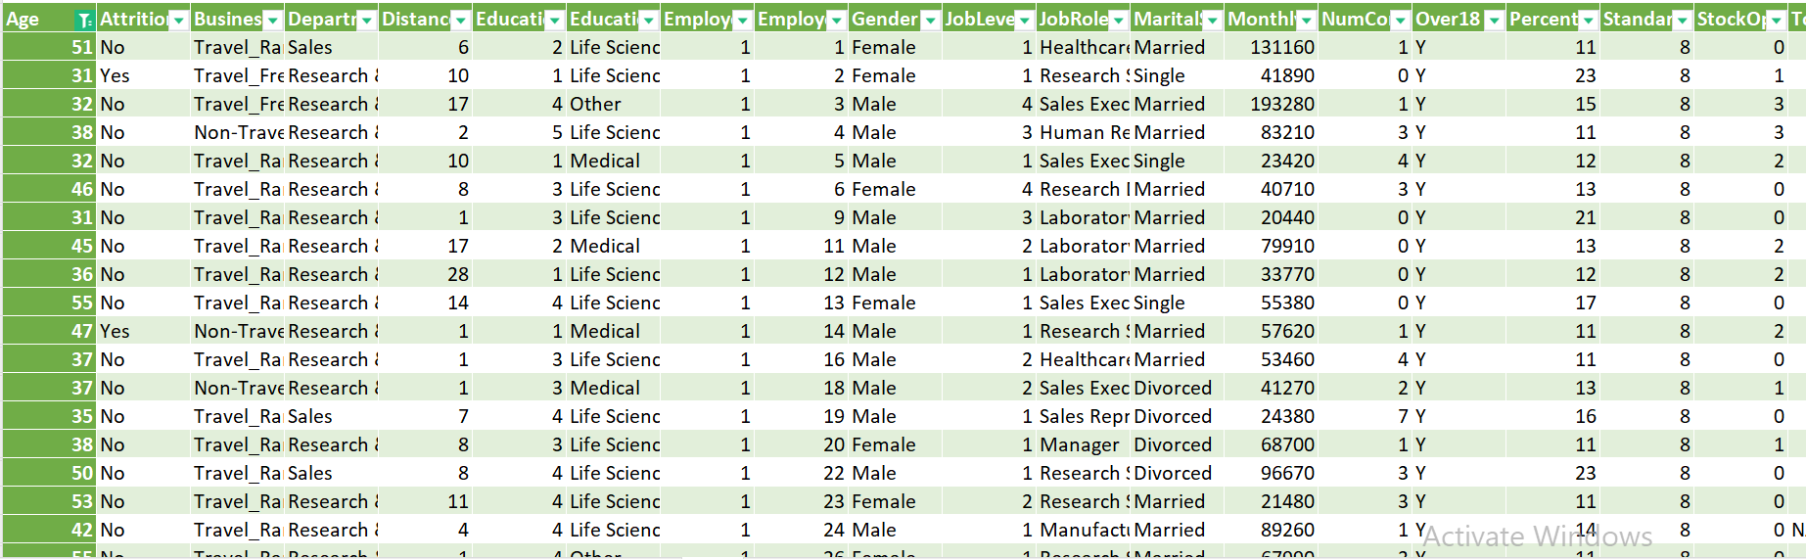
1. Using Excel, how would you filter the dataset to only show employees aged 30 and above?
Following the below steps to filter the dataset to only show Employees Age 30 and above :-
Go to Data Tab => Click on Filter => Select the column header arrow => Select Number Filters, and then select a comparison, like greater than or equal to => Enter the filter criteria(which is 30 in this case) and select OK.

Slide 3
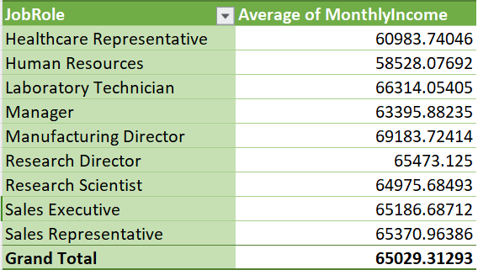
2. Create a pivot table to summarize the average Monthly Income by Job Role.

Slide 4
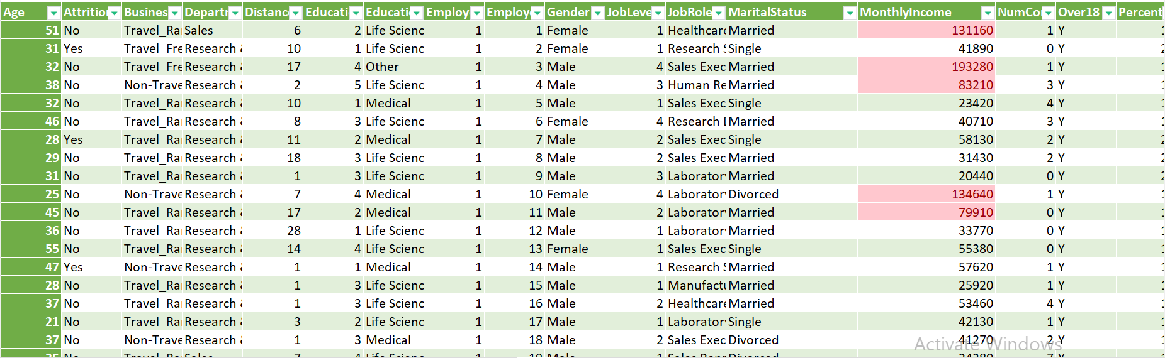
3. Apply conditional formatting to highlight employees with Monthly Income above the company's average income.

Slide 5
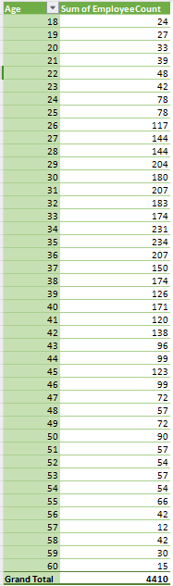
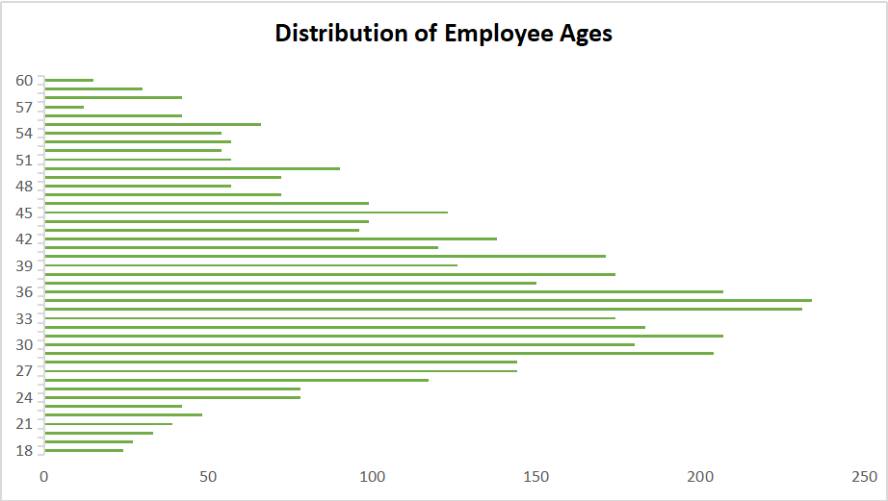
4. Create a bar chart in Excel to visualize the distribution of employee ages.

Slide 6
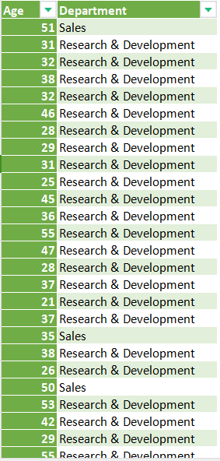
5. Identify and clean any missing or inconsistent data in the "Department" column.
Dealing with missing or inconsistent data values in categorical columns(like Department Column) is a lot easier. Simply I need to replace the missing or inconsistent value with a constant value or the most popular category. This is a good approach when my data size is small, though it does add bias. But the most preferable approach is to model the missing value in a categorical column(Department Column) as a new category called Unknown as our Dataset is large.
In the given Dataset, Department Column don’t have any missing or inconsistent value so there is no need to change anything in the Department Column.

Slide 7
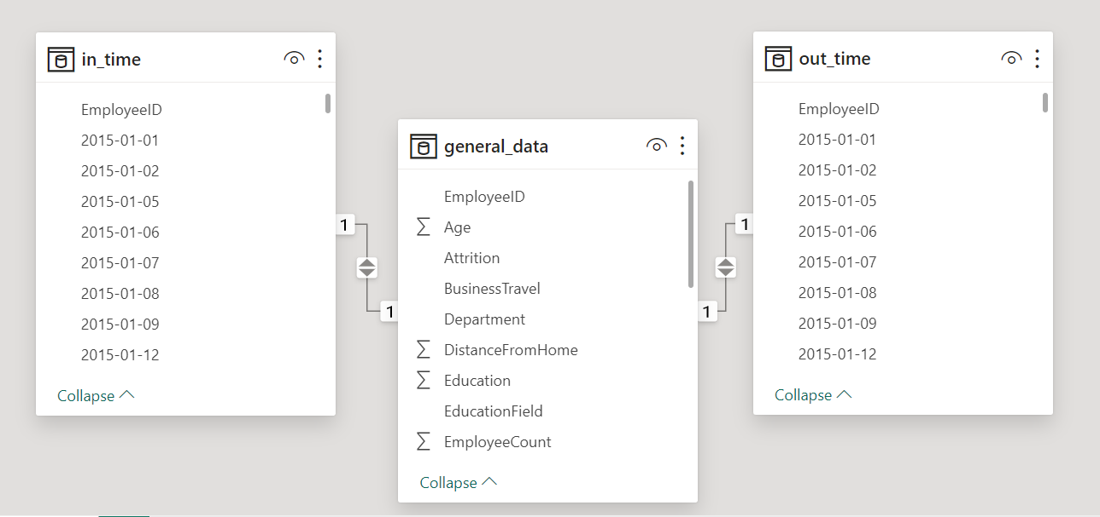
6. In Power BI, establish a relationship between the "EmployeeID" in the employee data and the "EmployeeID" in the time tracking data.

Slide 8
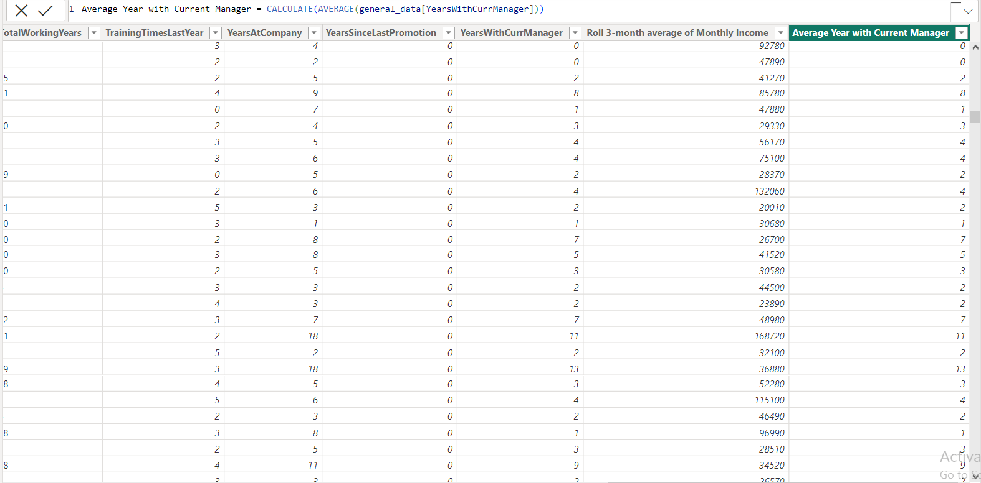
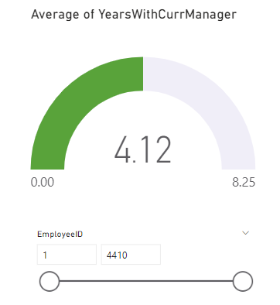
7. Using DAX, create a calculated column that calculates the average years an employee has spent with their current manager.

Slide 9
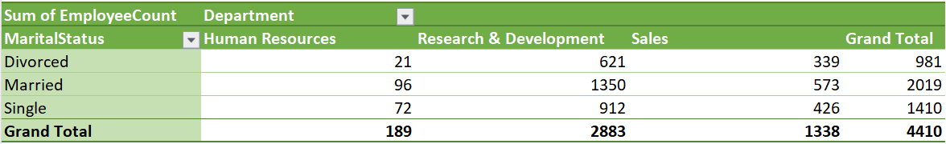
8. Using Excel, create a pivot table that displays the count of employees in each Marital Status category, segmented by Department.

Slide 10
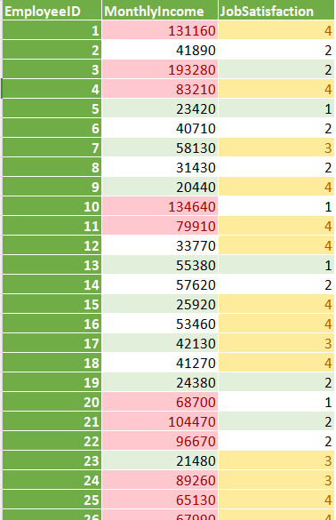
9. Apply conditional formatting to highlight employees with both above-average Monthly Income and above-average Job Satisfaction.

Slide 11
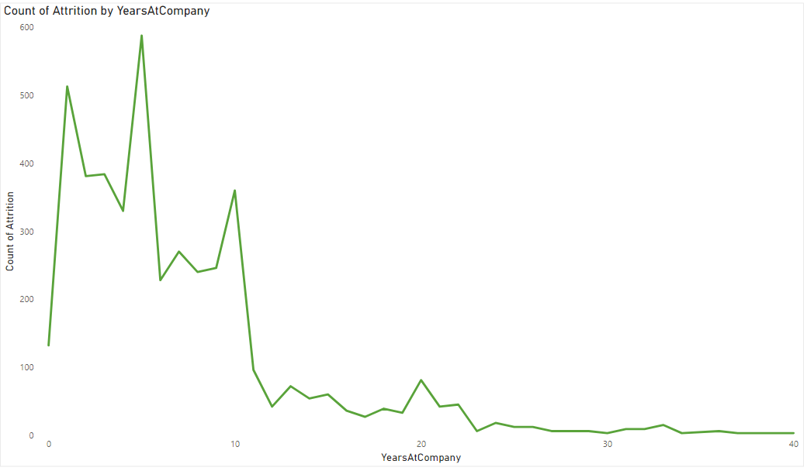
10. In Power BI, create a line chart that visualizes the trend of Employee Attrition over the years.

Slide 12
11. Describe how you would create a star schema for this dataset, explaining the benefits of doing so.
A star schema is a multi-dimensional data model used to organize data in a database so that it is easy to understand and analyze. Star schemas can be applied to data warehouses, databases, data marts, and other tools. The star schema design is optimized for querying large data sets.
A fact table sits at the center of a star schema database, and each star schema database only has a single fact table. The fact table contains the specific measurable (or quantifiable) primary data to be analyzed.
Dimension tables store supporting information to the fact table. Each star schema database has at least one dimension table, but will often have many. Each dimension table will relate to a column in the fact table with a dimension value, and will store additional information about that value.
Here, fact table is General Data Table and dimesion tables are Manager Survey Data, Manager Survey Data, In_Time Data and Out_Time. Tables are connected through Employee ID.

Slide 13
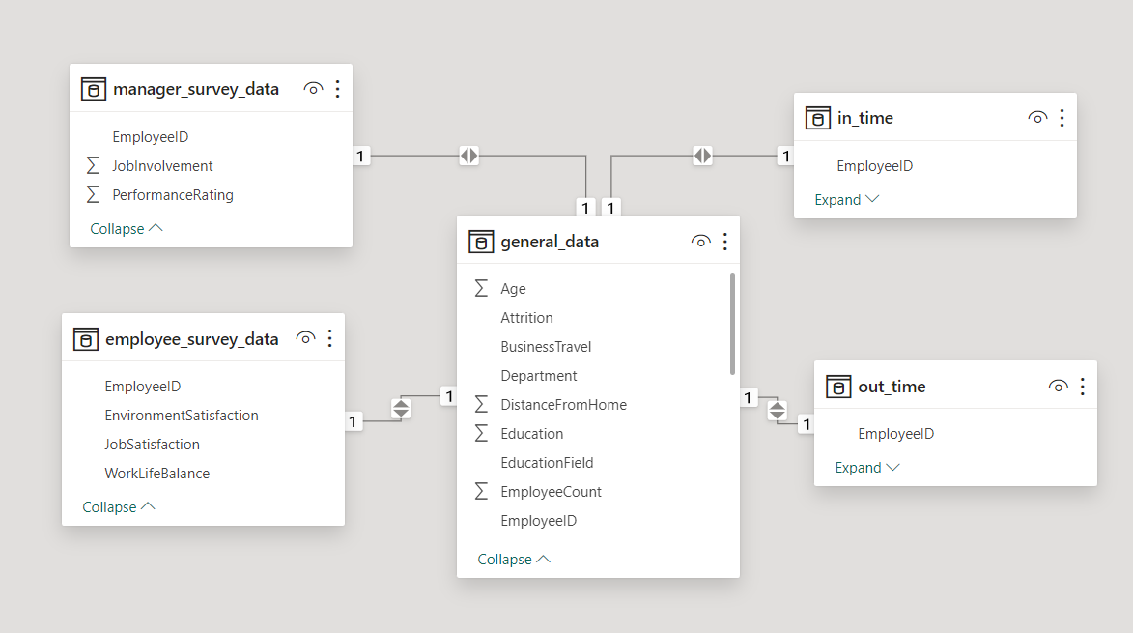

Slide 14
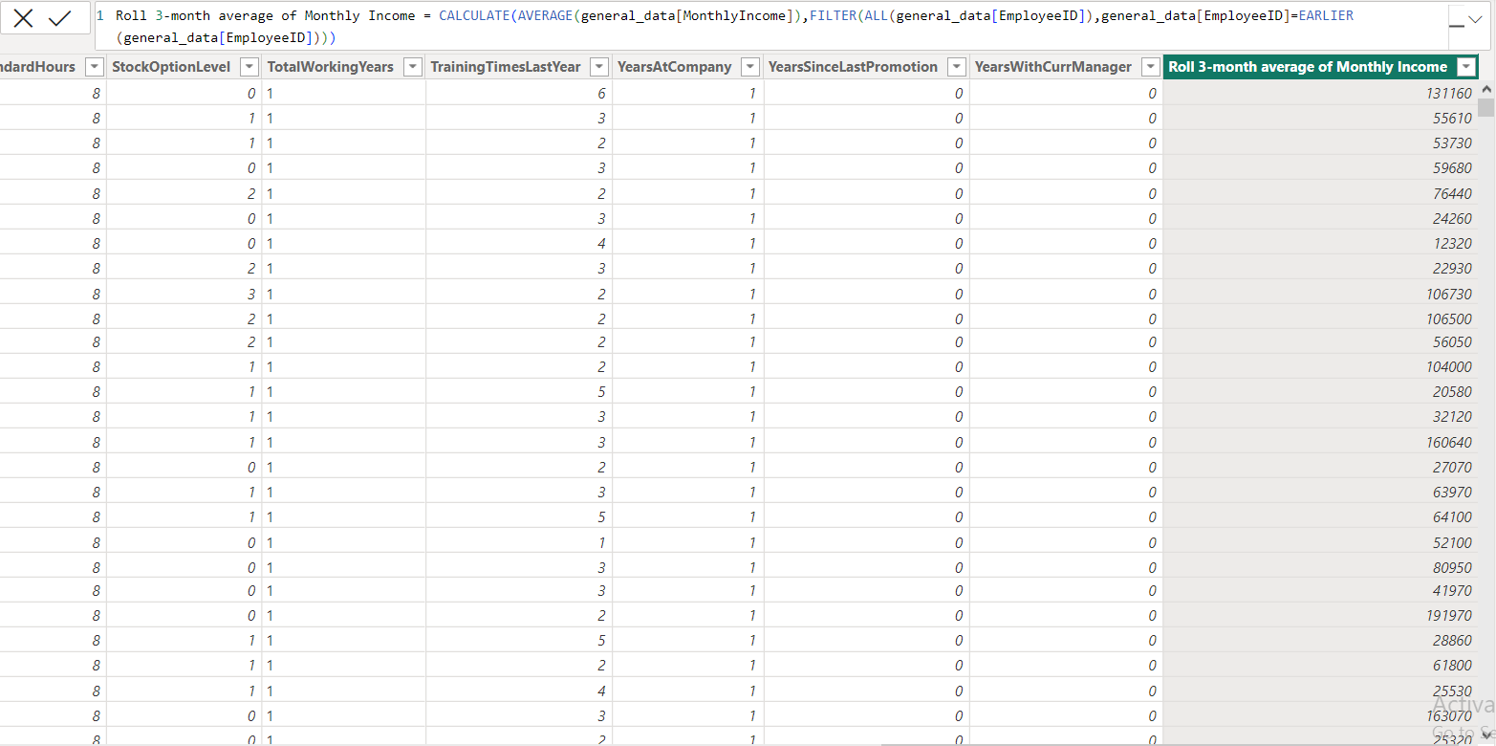
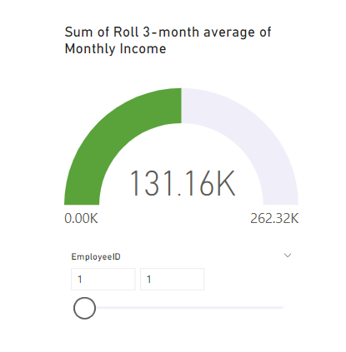
12. Using DAX, calculate the rolling 3-month average of Monthly Income for each employee.

Slide 15
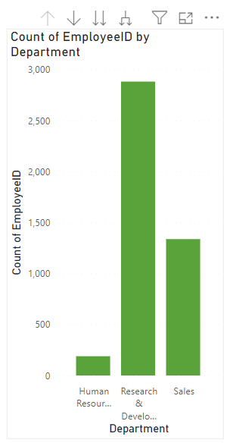
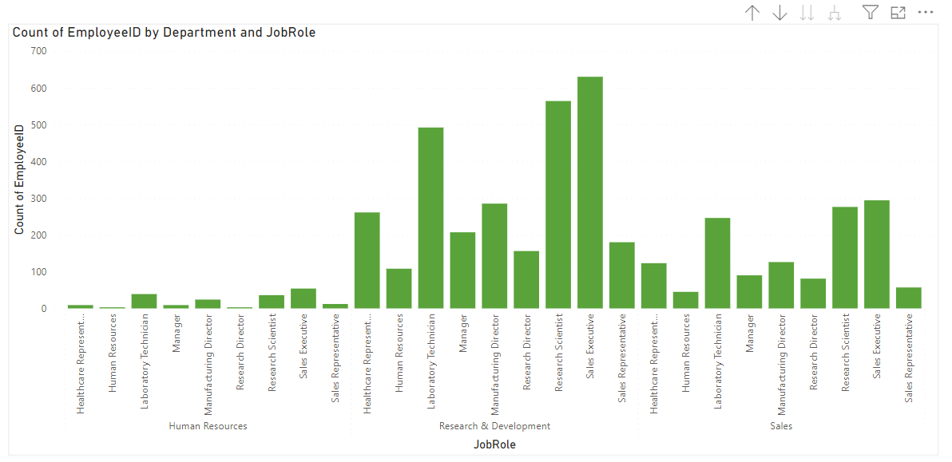
13. Create a hierarchy in Power BI that allows users to drill down from Department to Job Role to further narrow their analysis.

Slide 16
14. How can you set up parameterized queries in Power BI to allow users to filter data based 2 of 2 on the Distance from Home column?
In Power BI, we can set up parameterized queries using parameters in your queries. To filter data based on the distance from home column, follow these steps :-
Creating parameters - Go to “Home” tab => Click on “Manage Properties” => Creating Parameters
Modify Queries - Open Power Query Editor => Edit the Query => Use parameters
Load and use Parameters - Close & Apply Changes => Creating Visualizations & Use parameters in slicer or other filters
Paramterize Distance Column - If “DistanceFromHome” column is static and not a parameter, then we might to create a calculated column based on parameters.
Utilize Slicers - Creating slicer for our report canvas linked to the parameters we created.

Slide 17
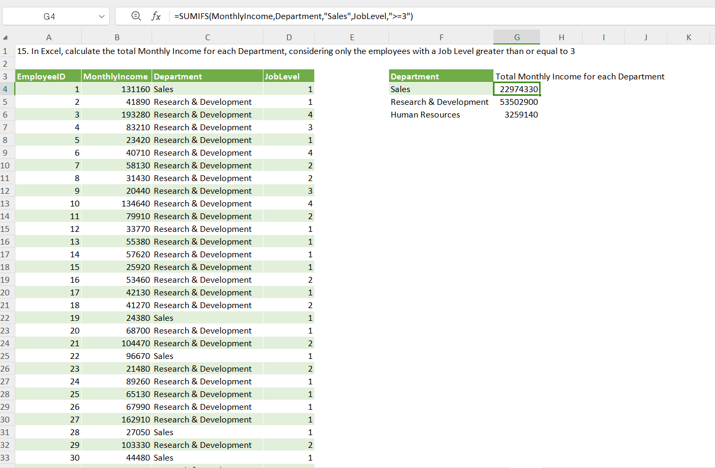
15. In Excel, calculate the total Monthly Income for each Department, considering only the employees with a Job Level greater than or equal to 3

Slide 18
16. Explain how to perform a What-If analysis in Excel to understand the impact of a 10% increase in Percent Salary Hike on Monthly Income.
The What-If Analysis in Excel is a powerful tool to perform complex mathematical calculations, experiment with data, and try out different scenarios. There are three What-If Analysis tools available :-
Goal Seek - It calculate input value based on given result. Goal Seek performs reverse calculations.
Scenario Manager - Scenario Manager is used for a comparison of different scenarios.
Data Table - Data Table is used for sensitivity analysis.
In the given dataset, for understanding the impact of 10% increase in Percent Salary Hike on Monthly Income I use Data Table tool of What-If Analaysis.
Firstly, I was calculated 10% Salary with the given salary as a Desired Salary then put the Desired Salary in blank cell in the same sheet. After that enter Monthly Income of all Employees in vertical cells and Percentage Increment in horizontal cell. Select the data and apply data table (Go to Data Tab => Click on What-If Analysis => Select Data Table). Put cell name of Percentage Hike in Row Input cell and cell name of Monthly Income in Column Input Data. Then click on OK. It will calculate 10% Percent Salary Hike for each employee based on their Monthly Income.

Slide 19
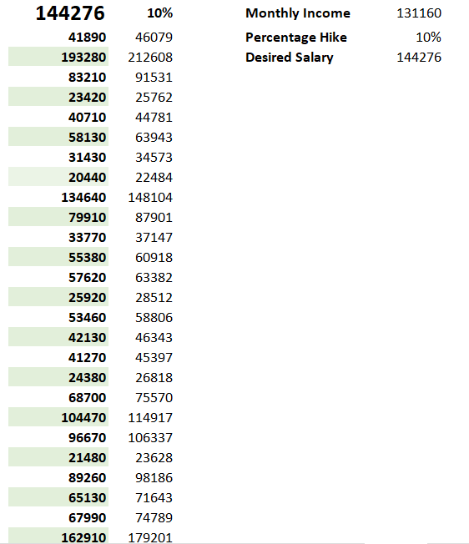

Slide 20
17. Verify if the data adheres to a predefined schema. What actions would you take if you find inconsistencies
Understand the Database Schema
Review Data Sources
Compare Dataset
Datatypes and Constraints
Date and Time Format
Applying filters and Conditional Formatting
Use Data Validation
Remove Duplicates
Identify Patterns and Outliers

Slide 21


